Slide 1
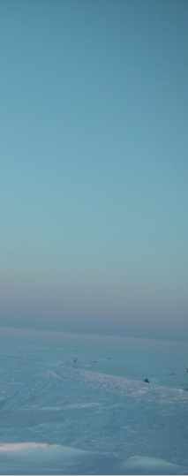

Digital Indigenous Democracy

Slide 2
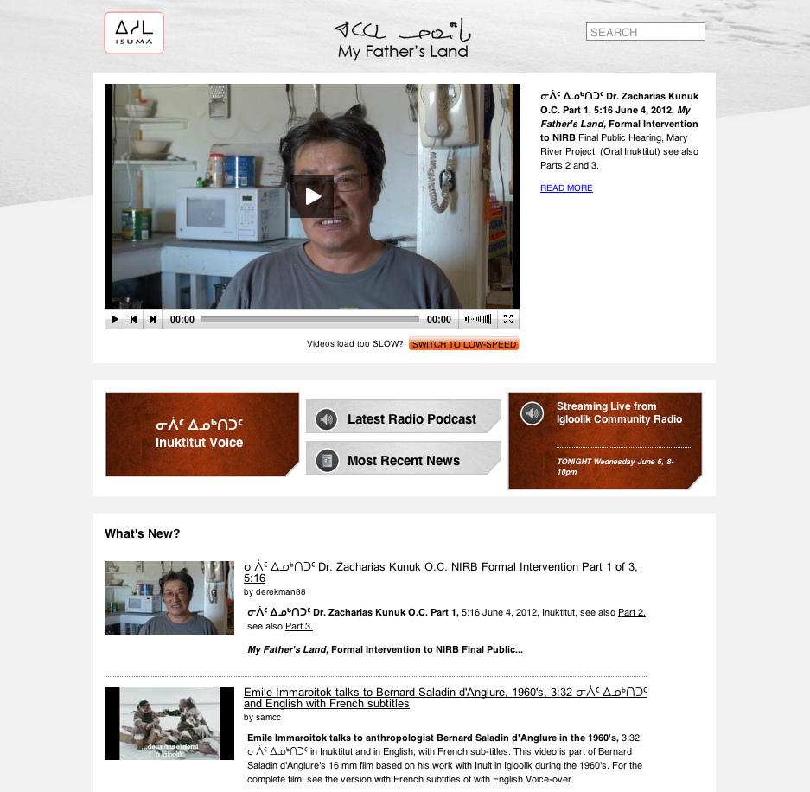
Homepage
www.isuma.tv/DID

Slide 3
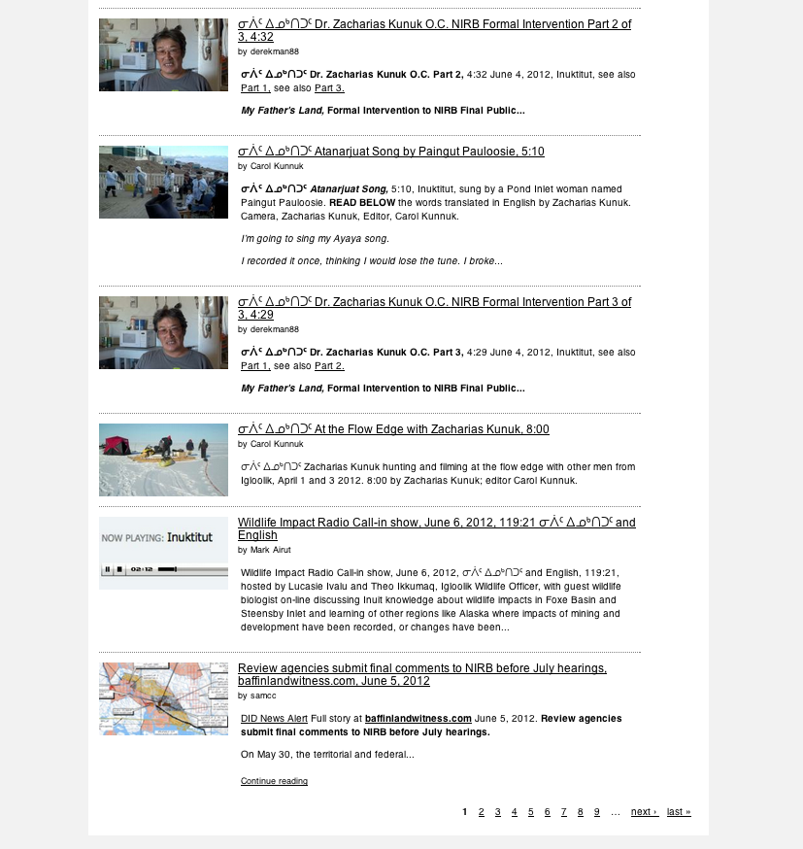
Homepage
www.isuma.tv/DID
…continuation 2 of 3

Slide 4
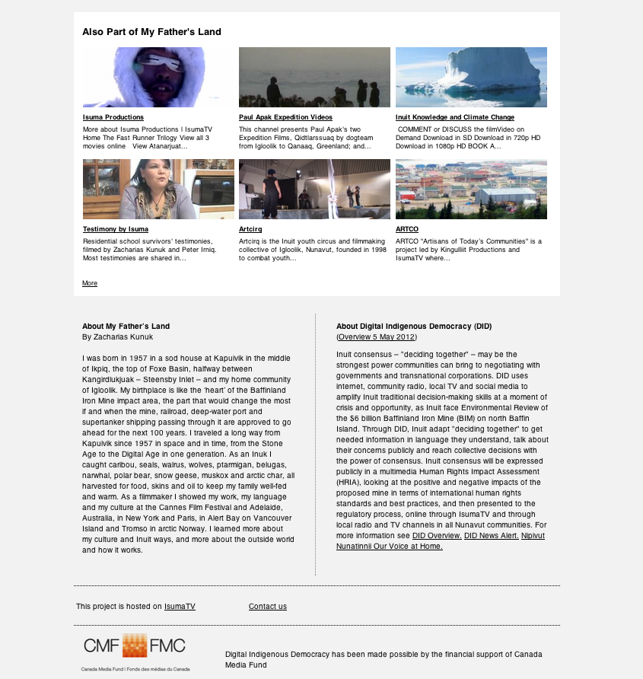
Homepage
www.isuma.tv/DID
…continuation 3 of 3

Slide 5
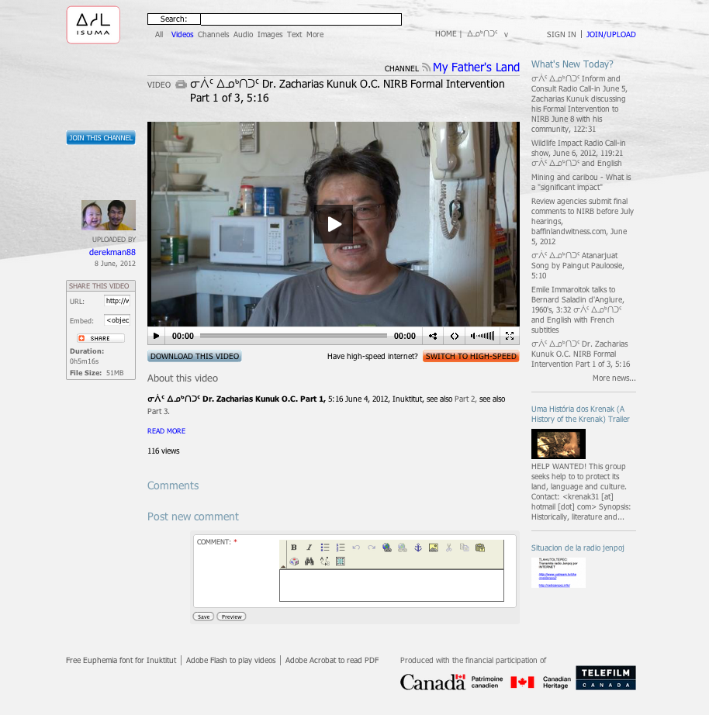
Summary Introduction
Zacharias Kunuk Intervention

Slide 6
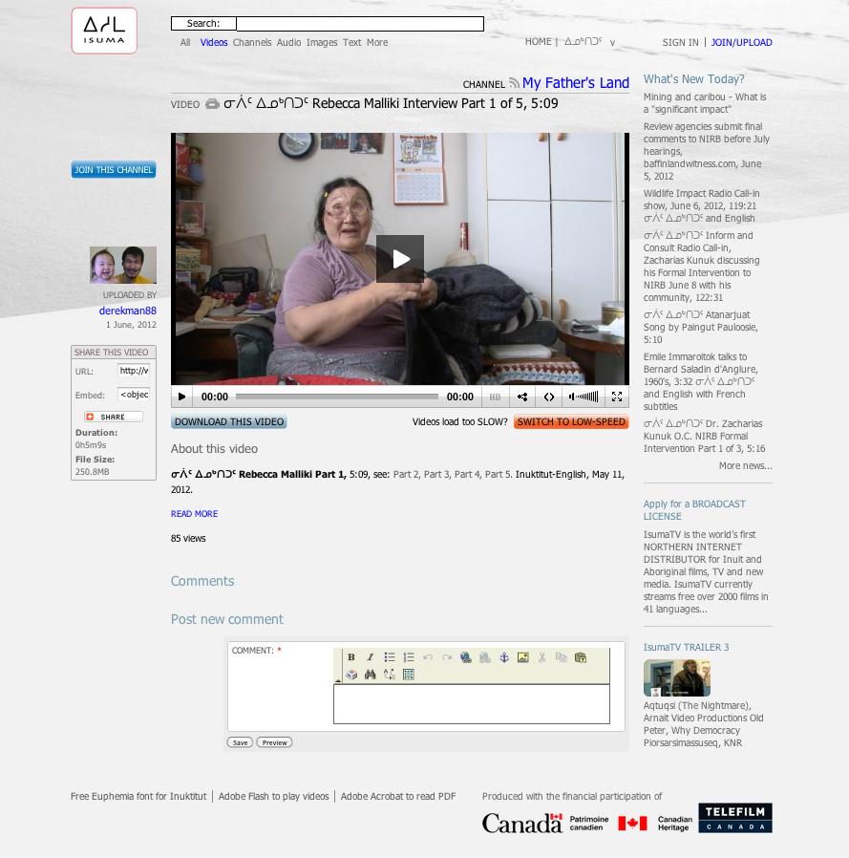
Video Interviews
Rebecca Malliki Part 1

Slide 7
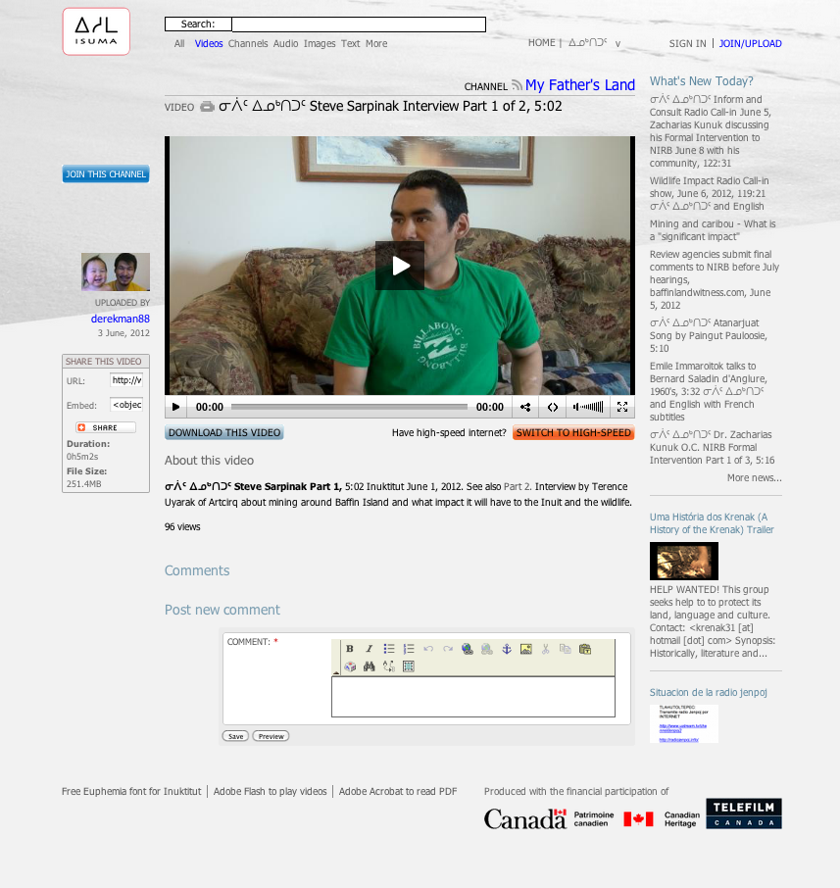
Video Interviews
Steve Sarpinak Part 1

Slide 8
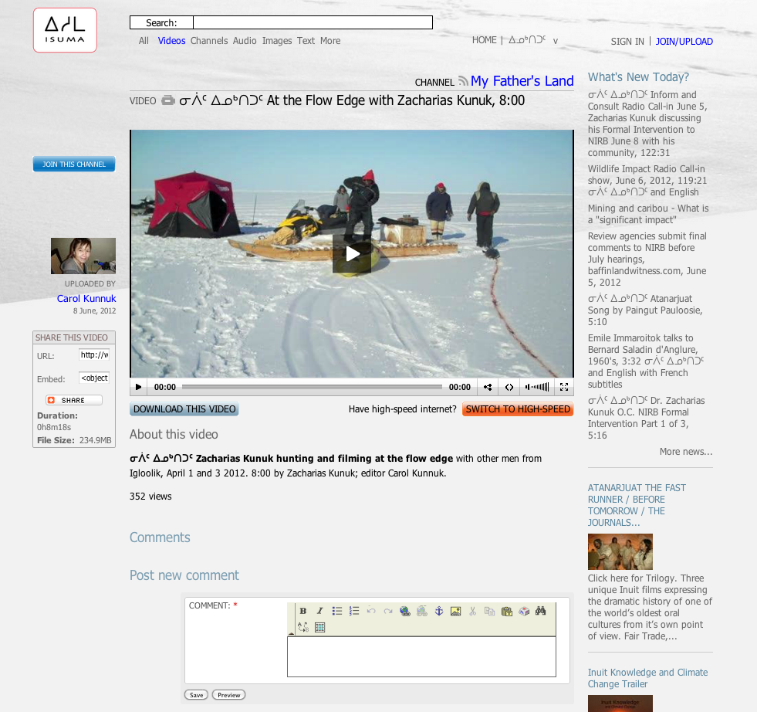
Personal Videos
At the floe edge with Zacharias Kunuk

Slide 9
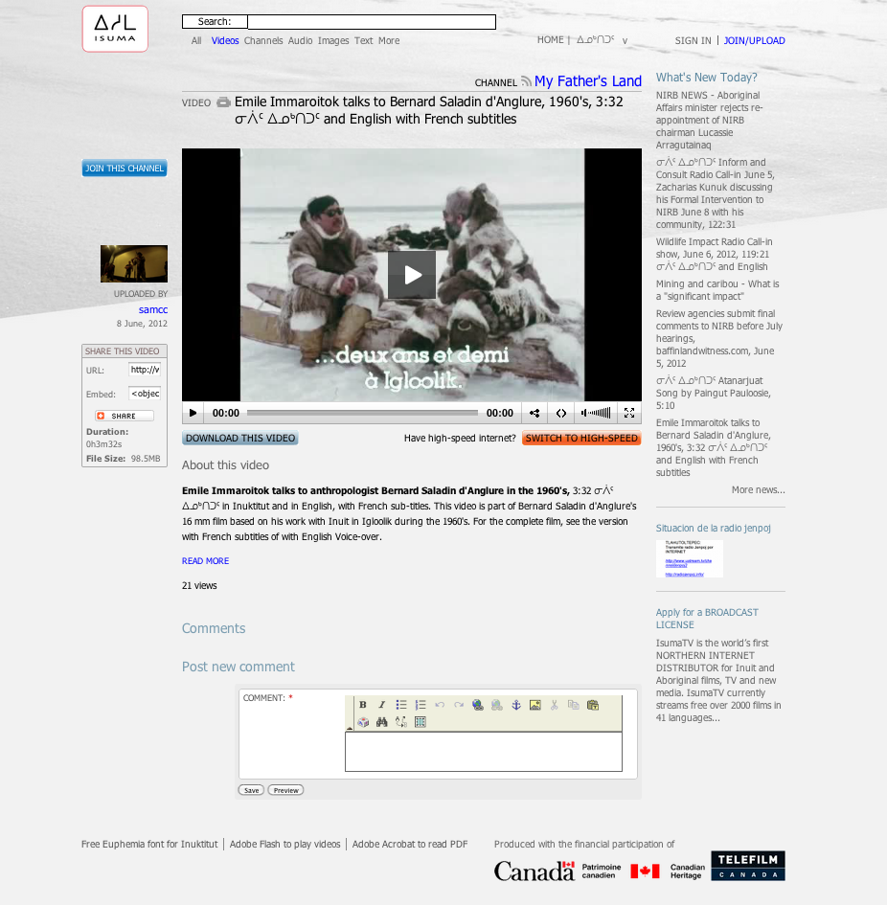
Personal Videos
Emile Immaroitok 1960's

Slide 10
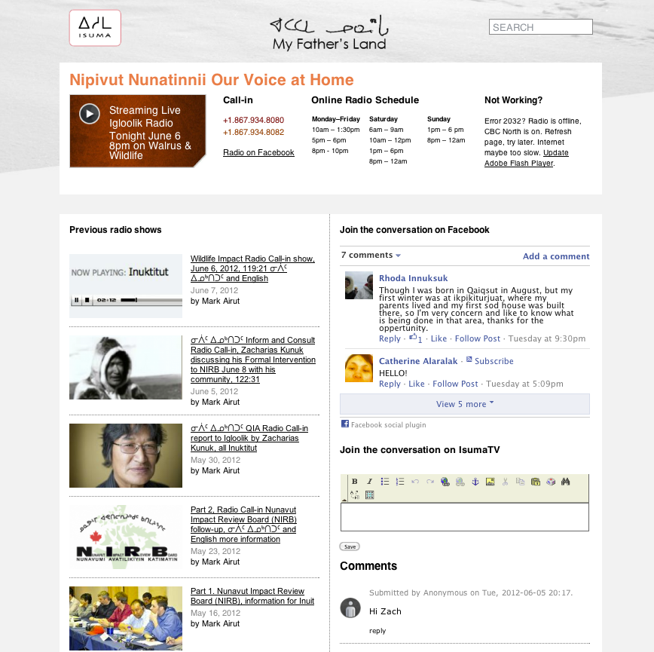
Radio Online
www.isuma.tv/DID/radio/igloolik

Slide 11
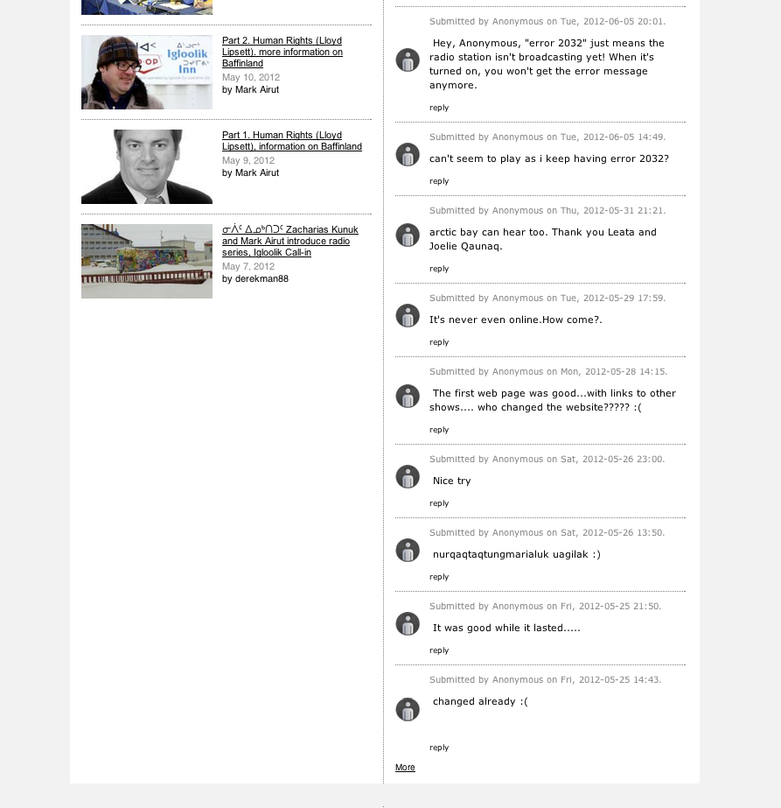
Radio Online
www.isuma.tv/DID/radio/igloolik
…continuation 2 of 2

Slide 12
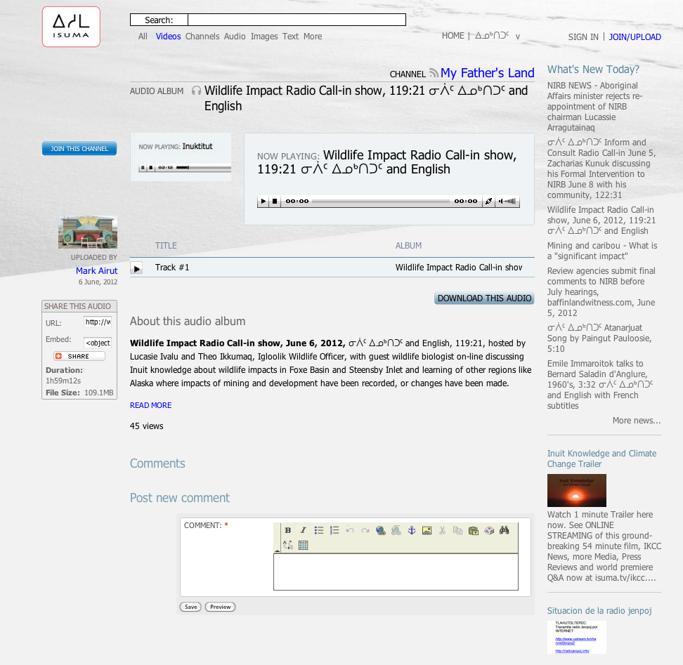
Radio Call-in
Wildlife Impact Radio Call-in June 6

Slide 13
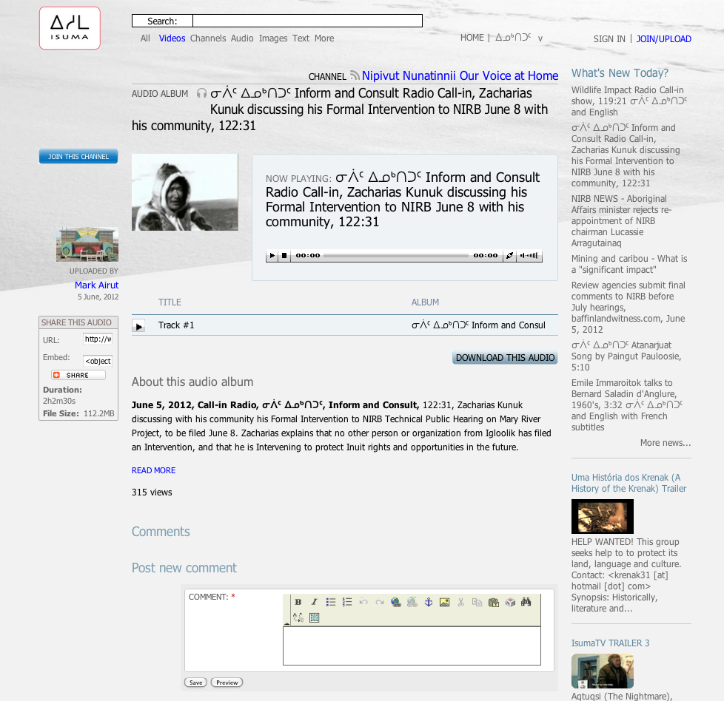
Radio Call-in
Inform and Consult Radio Call-in June 5

Slide 14
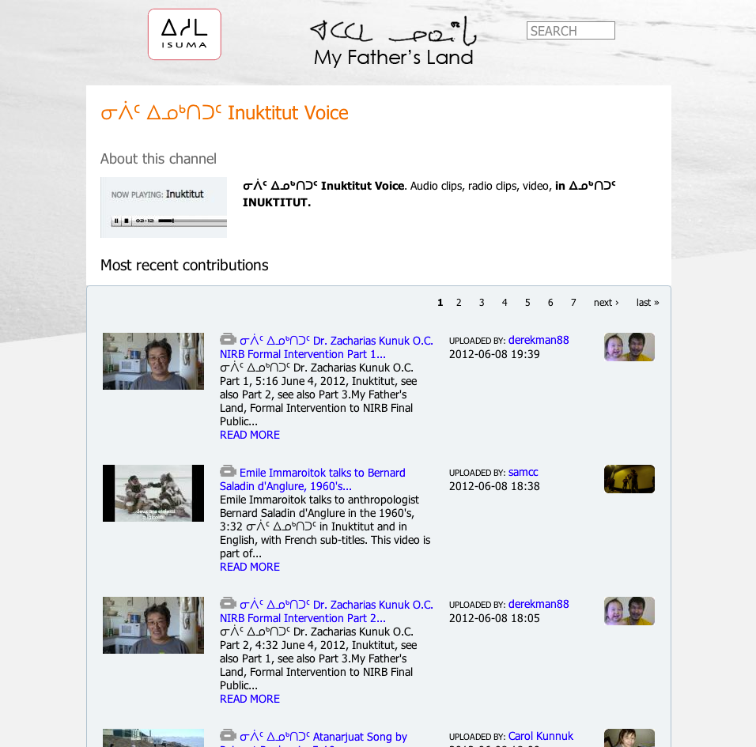
Inuktitut Voice
www.isuma.tv/Inuktitutvoice

Slide 15
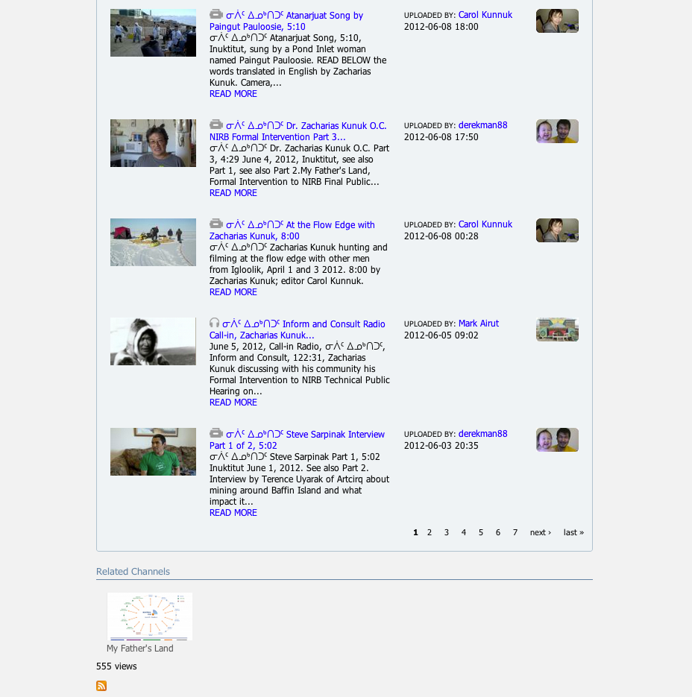
Inuktitut Voice
www.isuma.tv/Inuktitutvoice
…continuation 2 of 2

Slide 16
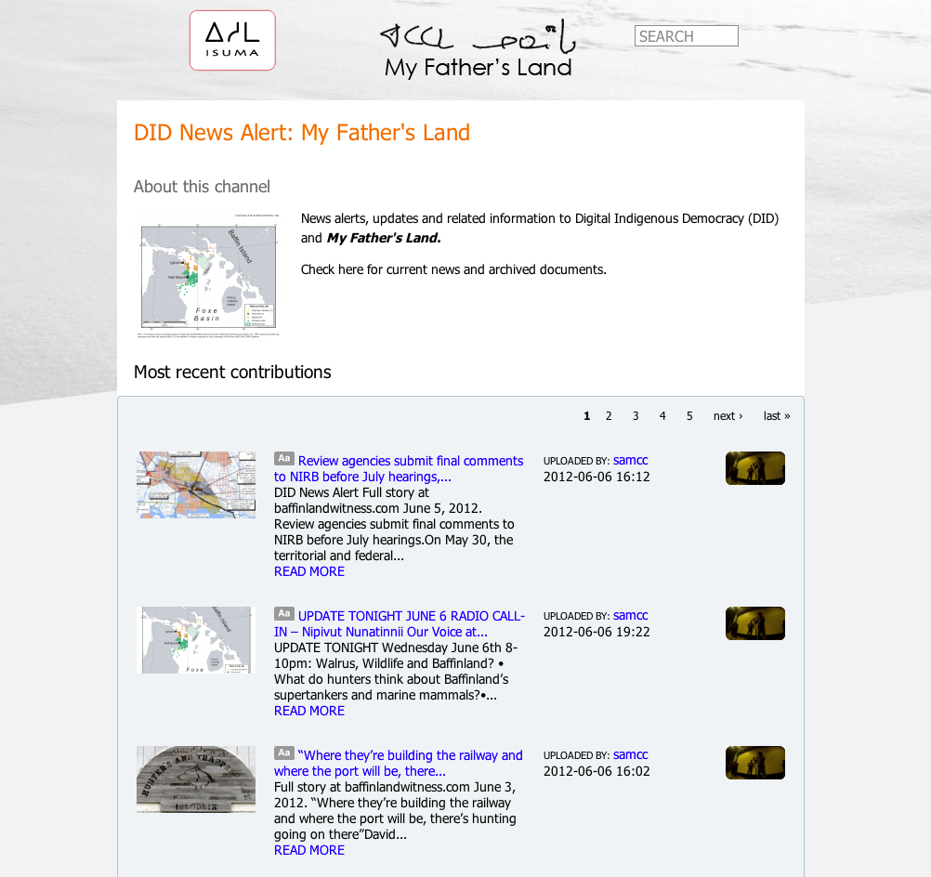
Most Recent News
www.isuma.tv/DID-news-alert

Slide 17
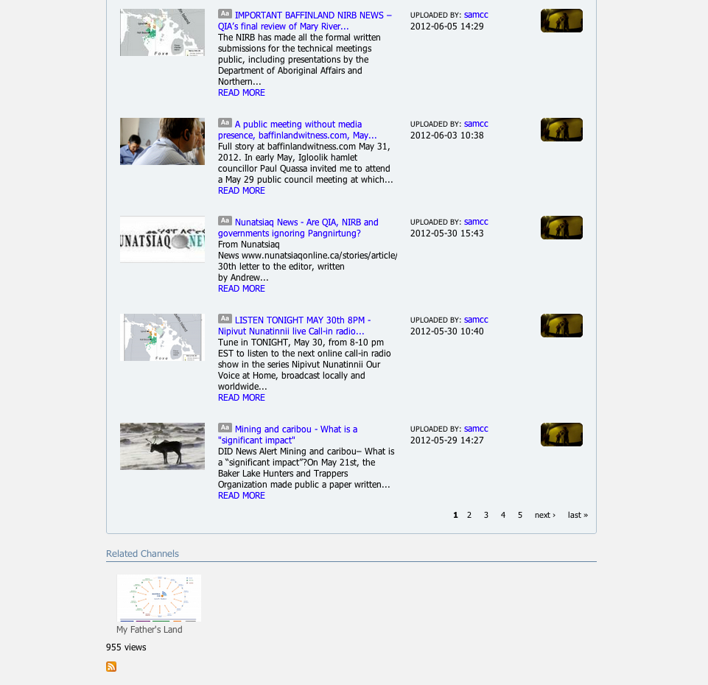
Most Recent News
www.isuma.tv/DID-news-alert
…continuation 2 of 2

Slide 18
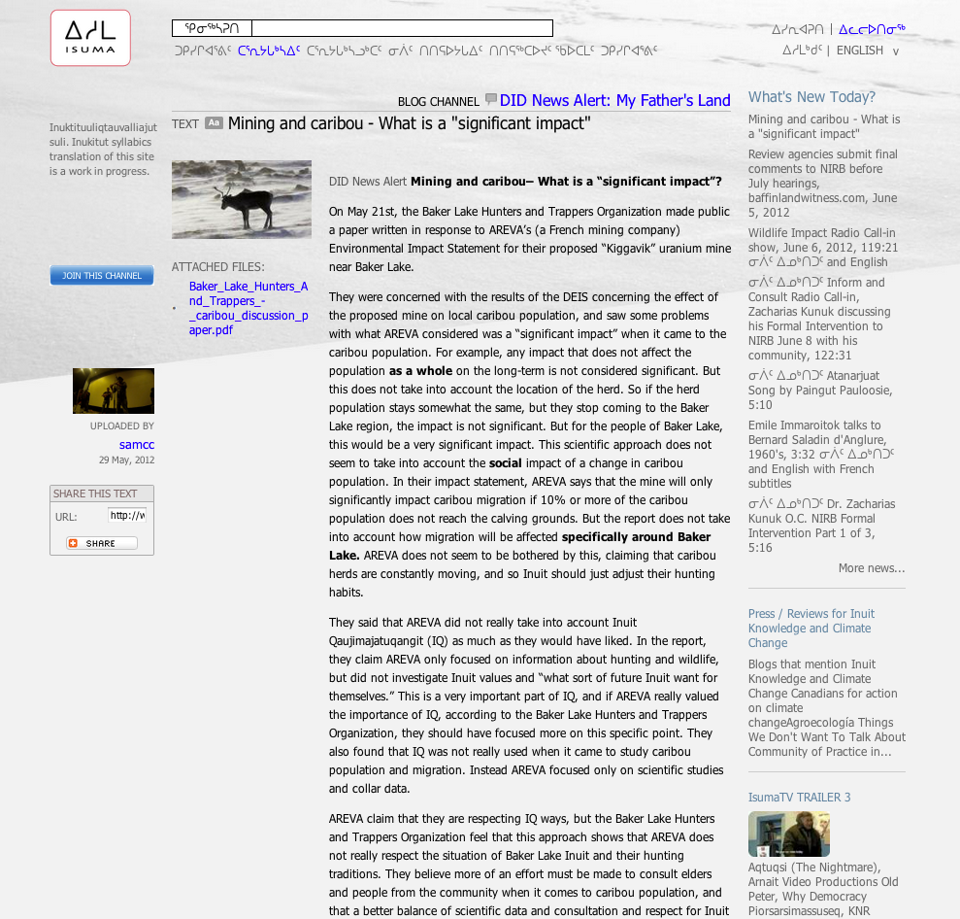
News Alert
Mining and Caribou Impact

Slide 19
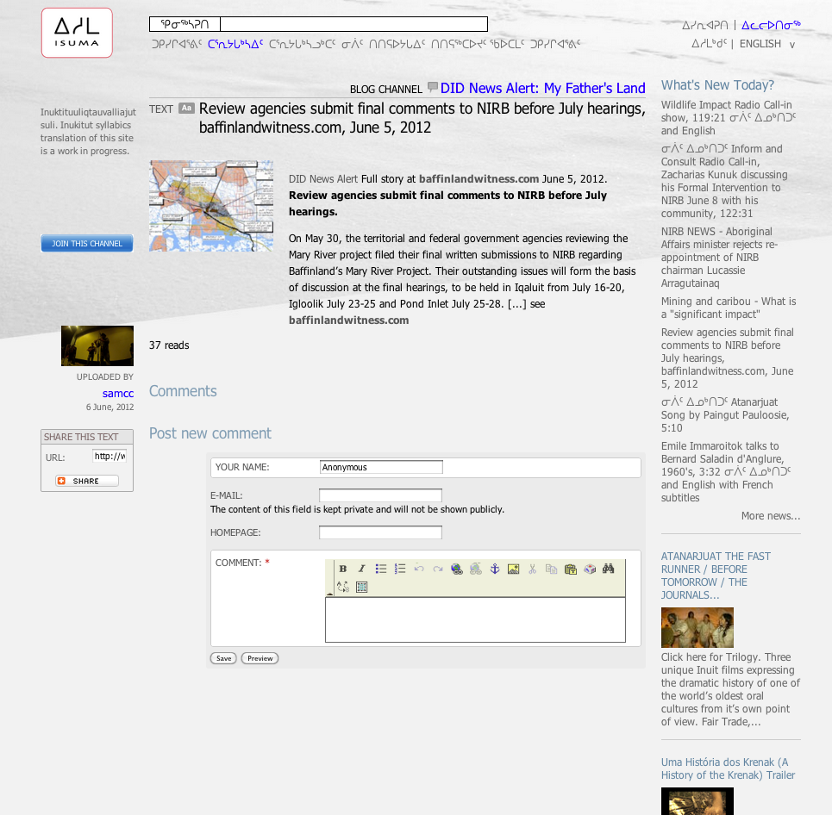
News Alert
Review Agencies submit final comments

Slide 20
Digital Indigenous Democracy
www.isuma.tv/DID

